Slide 1

More Mileage from Your Tools: Problem Isolation with TLS and TCP
George Cragg
Dräger Medical Systems, Inc.
https://github.com/gacragg-github/Sharkfest2023 -or- https://bit.ly/3MNrVSF

Slide 2
Hello!
I am George Cragg
You can find me at george.cragg@draeger.com / gacragg@gmail.com or on LinkedIn. I am a network engineer/wireless specialist with a medical device company near Boston, MA.
https://github.com/gacragg-github/Sharkfest2023 -or- https://bit.ly/3MNrVSF

Slide 3
Abstract
As a network tool, Wireshark is often used for diagnosis and to prove/disprove the network contribution to various communication problems that inevitably arise. Here we explore a case study of problem isolation down to a finer level than just 'it's not the network'.
https://github.com/gacragg-github/Sharkfest2023 -or- https://bit.ly/3MNrVSF

Slide 4
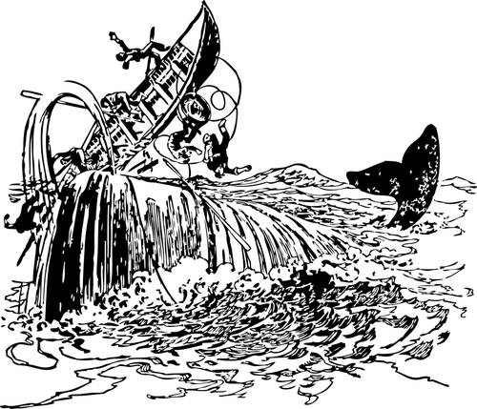
Sea Story Time
Using Our Favorite ToolTM to solve real-world problems
Can we provide more value than just it’s not the network?
Some basic review of TCP and TLS features
Highlight some of the different stakeholders under different scenarios
https://github.com/gacragg-github/Sharkfest2023 -or- https://bit.ly/3MNrVSF

Slide 5
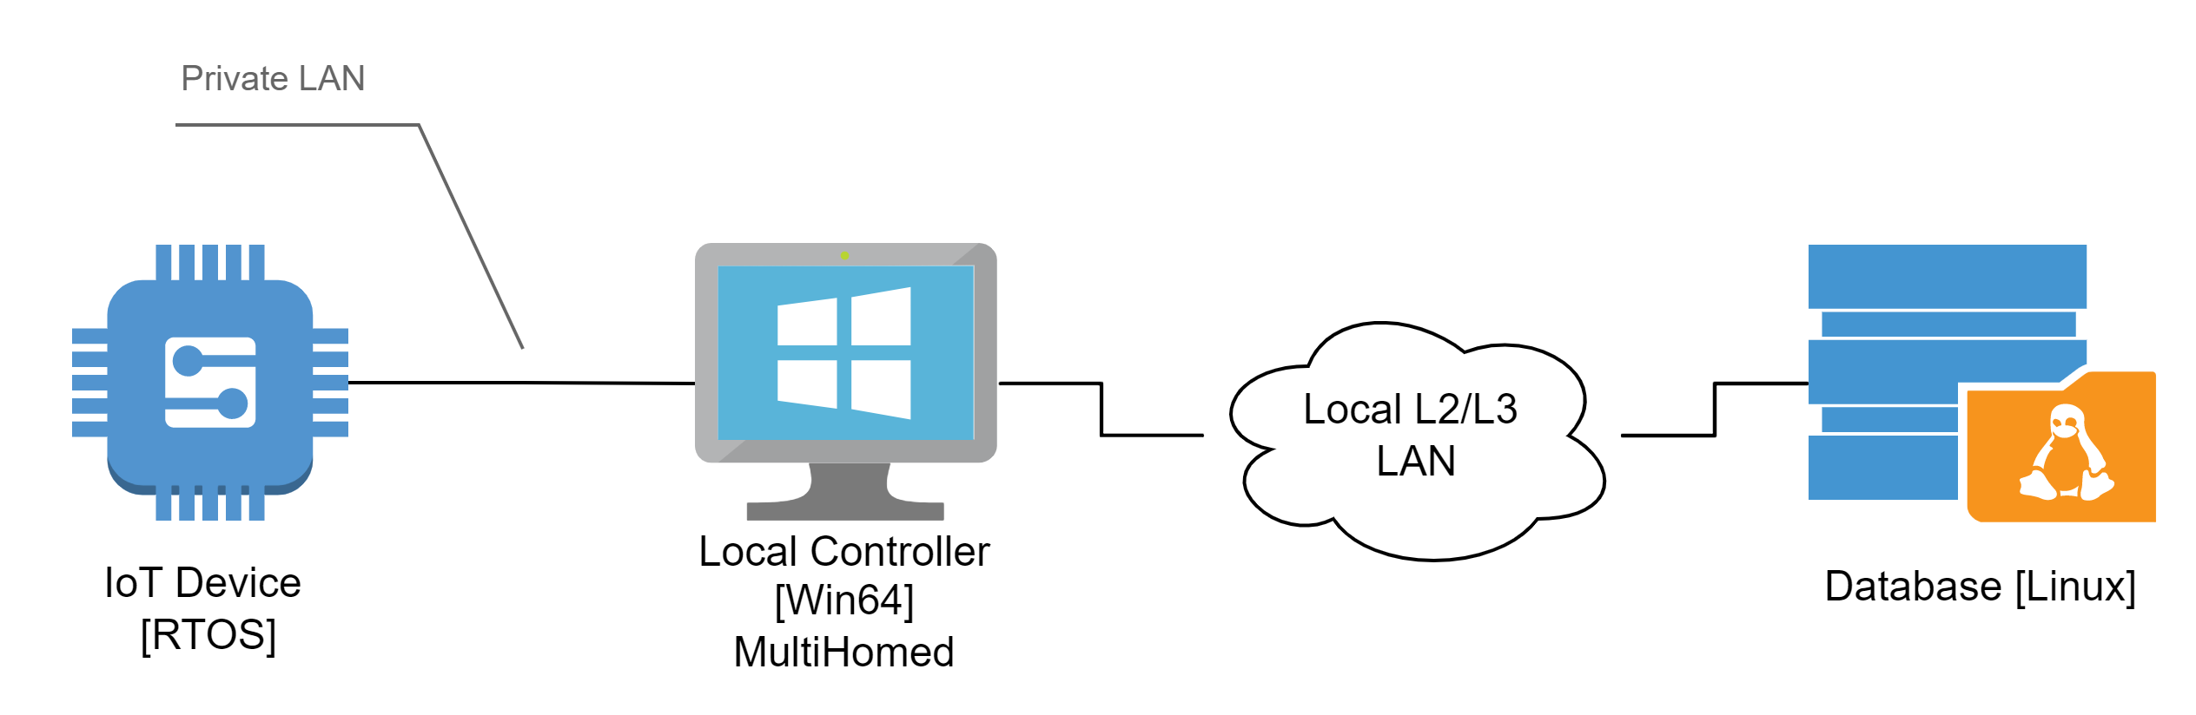
The case of ‘we added security and now the network is broken’
https://github.com/gacragg-github/Sharkfest2023 -or- https://bit.ly/3MNrVSF
Process: IoT device is locally controlled by Windows system & sends reports to remote Linux platform
Problem: Once security is enabled, reports are no longer available in database and error is generated (Linux log)

Slide 6
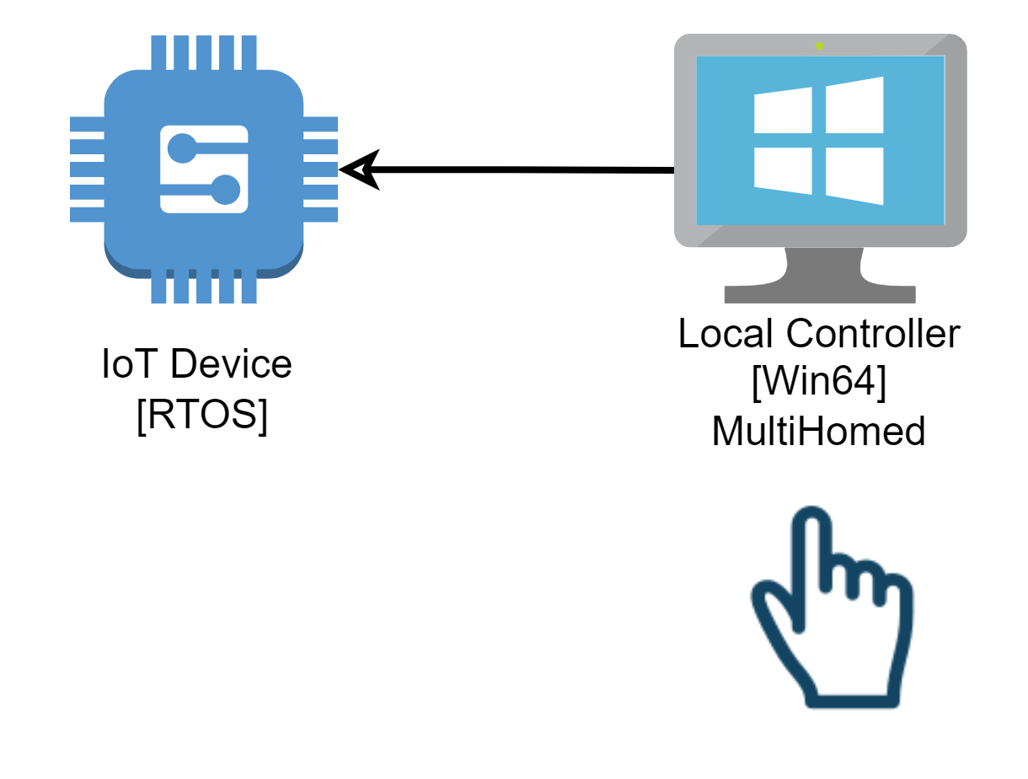
How it works - 1
Local controller model is kiosk-style app

Slide 7
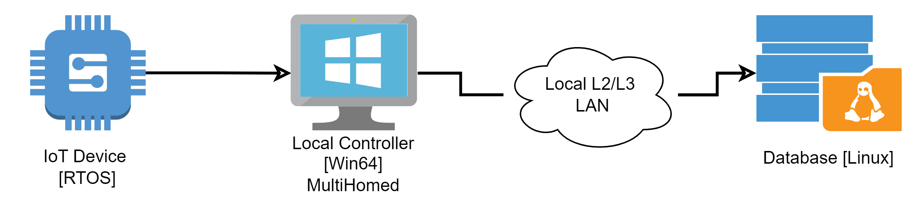
How it works - 2
“Worked fine before, but when we enable security, the network blocks the traffic”
Q: Do you use TCP or UDP? A: ….
Q: How did you add security? A: TLS

Slide 8

Players
Three different teams
Embedded
Windows
Linux
What about network?
Usual…

Slide 9
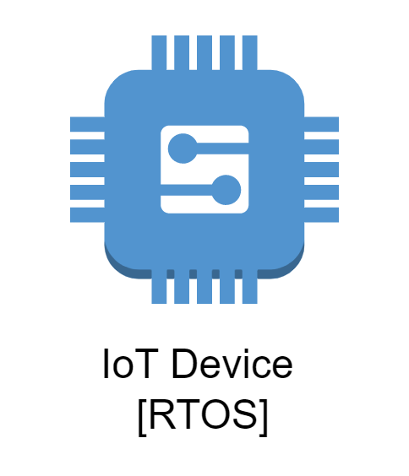

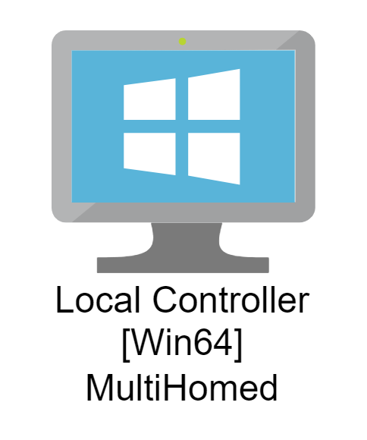

Even Better
“All I did was add TLS”
“I do a packet-by-packet copy”
“Works fine without security so must be sending me bad data – maybe changed by the network”

Slide 10
Some things we need
TCP
Reliable
Ordered
Flow control
Byte stream
No message boundary expressed or implied
TLS
Confidentiality/Integrity/ Authentication (CIA)
Works on top of TCP
Uses Record Protocol to move protected data

Slide 11
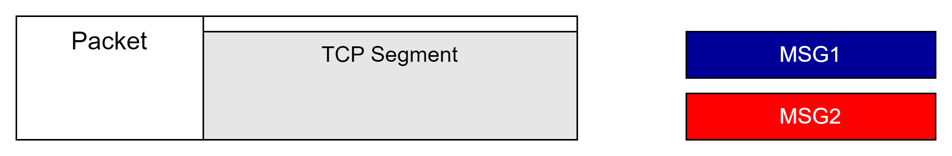
Some things we need
Multiple points of data agglomeration
Reduce overhead for Efficiency by accumulation
Application layer messages
Protected TLS record
TCP segments

Slide 12
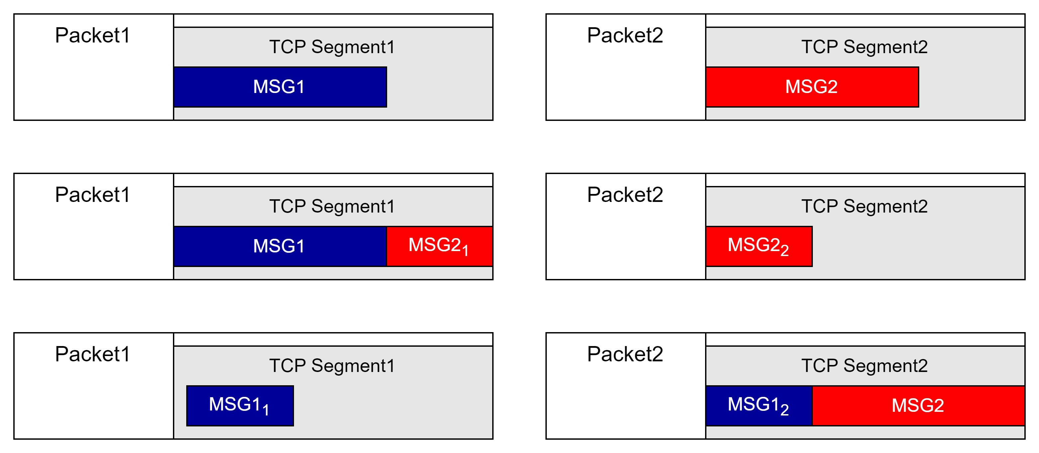
Segmentation Schemes

Slide 13
Segmentation Schemes

Slide 14
Segmentation Schemes

Slide 15
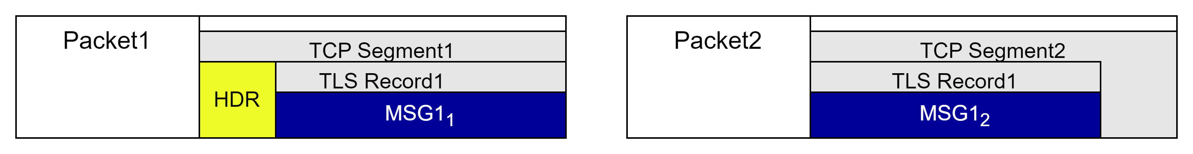
Segmentation Schemes

Slide 16
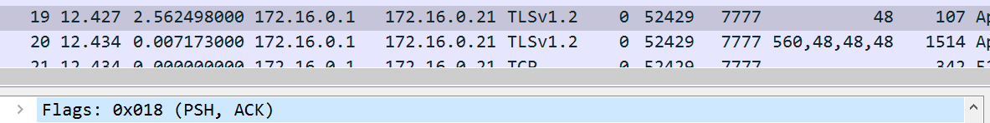
TCP PSH Flag
RFC793
Search Google: discussion about usefulness and specific behavior
A sending TCP is allowed to collect data from the sending user and to send that data in segments at its own convenience, until the push function is signaled, then it must send all unsent data. When a receiving TCP sees the PUSH flag, it must not wait for more data from the sending TCP before passing the data to the receiving process.

Slide 17
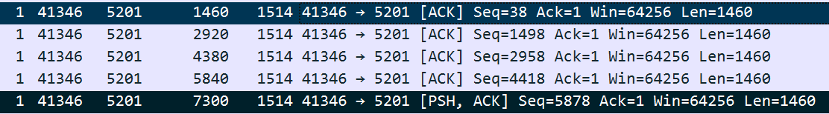
TCP PSH Flag
Talk to others to debate true meaning and possible subtleties
Practically I share my experience but defer to experts:
Either always set when data is present (tcp.len >0)
Indicates send buffer size of transmitter

Slide 18
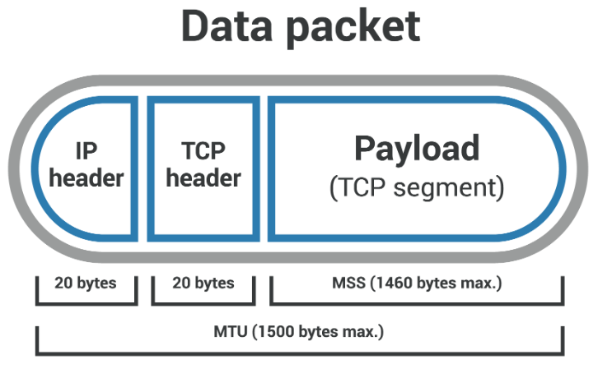
TCP MSS
TCP actors announce the maximum data payload they can receive
Sent with SYN as an option field
Common maximum: 1460
Default: 536
Warning: middle boxes can perform MSS Clamping
Notes:
Image from https://www.cloudflare.com/learning/network-layer/what-is-mss/

Slide 19
TLS Alert
TLS protocol supports mechanism to provide information on errors
RFC5246
Alert messages convey the severity of the message (warning or fatal) and a description of the alert
Once session established contents are protected i.e. specific details are encrypted
enum {
close_notify(0),
unexpected_message(10),
bad_record_mac(20),
decryption_failed_RESERVED(21),
record_overflow(22),
decompression_failure(30),
handshake_failure(40),
no_certificate_RESERVED(41),
…

Slide 20

Reverse Engineering
How does process work from my simple point of view?
My means how I think about what is happening in the context of network traffic
Capture

Slide 21
Reverse Engineering
Approach – observe failure
Capture on-network traffic (not on-host - why?) at appropriate location – as close to source as possible
Ask SME to trigger operation, wait a few seconds, then trigger again. Feedback on failure - errors show in the app logs. On success, indicated as such in app logs.
Can we find it? I rarely use timestamps…
Dataset: 1_ReverseEngineerProfile.pcapng
https://github.com/gacragg-github/Sharkfest2023 -or- https://bit.ly/3MNrVSF

Slide 22
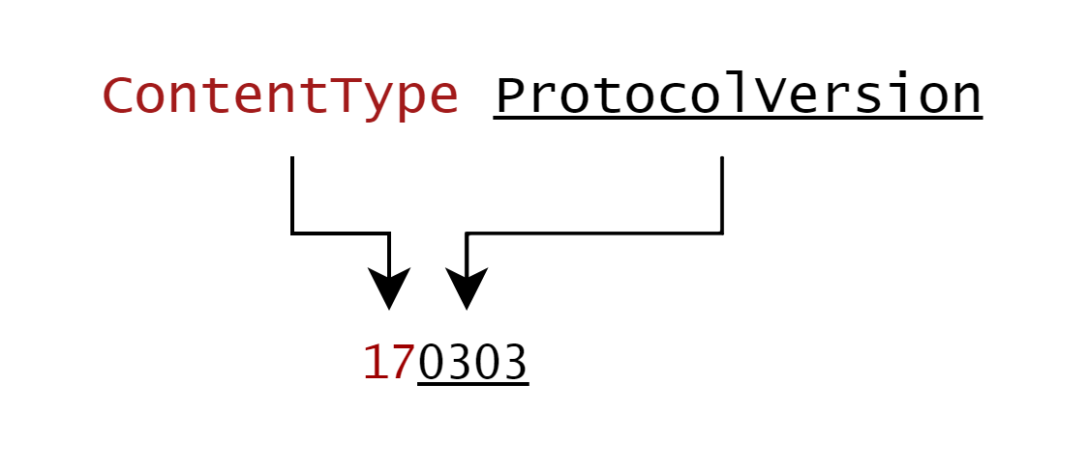
Reverse Engineering with RFC5246
A.1. Record Layer
struct {
uint8 major;
uint8 minor;
} ProtocolVersion;
ProtocolVersion version = { 3, 3 }; /* TLS v1.2*/
enum {
change_cipher_spec(20), alert(21), handshake(22),
application_data(23), (255)
} ContentType;
struct {
ContentType type;
ProtocolVersion version;
uint16 length;
opaque fragment[TLSPlaintext.length];
} TLSPlaintext;
ContentType | As hex
change_cipher_spec(20) | 0x14
alert(21) | 0x15
handshake(22) | 0x16
application_data(23) | 0x17

Slide 23
Reverse Engineering
Notes
IO Graph funnel: all → tcp → tcp.flags.syn == 1
Packet pane: find port with tcp.flags.syn == 1
Check flow of that port on IO graph tcp.port == 7777
No decoder – check bytes with follow stream
https://www.rfc-editor.org/rfc/rfc5246#page-68
All start with ContentType, Version
Set decode as to TLS
Looks good to me… at least TLSv1.2 in use

Slide 24
Packet-by-Packet copy
Pray tell… what is this? L3 Routing? Proxy? NAT?
Dataset: 2_IOT.pcapng
Dataset: 2a_LocalController.pcapng
Capture
Capture

Slide 25
Packet-by-Packet copy
Approach – compare packets streams at different points
Model | Possible Differences
L3 | IP Addressing
L3 | TTL
L3 | QoS
L4 | TCP Ephemeral port
L4 | TCP Options
L4 | TCP Segmentation
L4 | TCP Seq No. (absolute)
L7 | TLS Handshake parameters

Slide 26
Packet-by-Packet copy
Findings
Not a packet-by-packet copy
TCP connection is terminated at Local Controller and a new one is formed
TLS session is pass-thru: end to end protection extends through Local Controller but bytes are re-segmented
Better model description: byte-by-byte copy (?)
Result
Nothingburger here – does not behave the way developer thinks it does, but behavior is not faulty in any observed way
Even if these changes turn out to be root cause, system needs to be able to handle this
Behavior is within TCP/TLS envelope & compliant to RFCs

Slide 27

What does good look like?
Remember – I am a one-trick pony
I need to see the operation from the point of view of the communication profile
where Wireshark comes in
Disable TLS at system level, and let's see a successful run
Dataset: 3_IOT_noTLS.pcapng
Notes:
Pony: Designed by Freepik

Slide 28
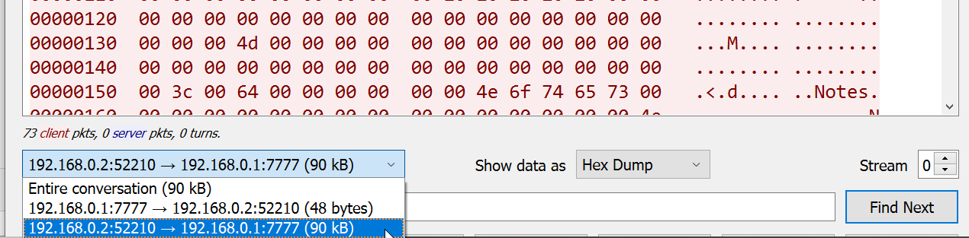
What does good look like?
Approach
IO Graph
Follow stream → view as hex dump
Focus on client to server by selecting direction in the drop down

Slide 29
What does good look like?
We can export the client data to a file for later use
Why do I want to do that, you ask?
Because I want to isolate the problem away from the products and provide my own clients/servers under my control to probe behavior
I don’t know the underlying protocol and really don’t want to
Follow TCP Stream → (select client: → 192.168.0.1:7777) → Show data as Raw → (copy and paste)

Slide 30
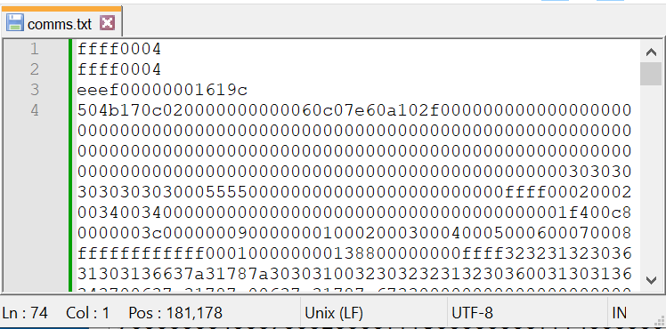
Extract Client Data
Open said file… these are the bytes sent by the client
LF 0x0a or CRLF 0x0d0a added to each segment
Not part of protocol

Slide 31
What does failure look like?
Dataset: 2a_LocalController.pcang
Server throws Encrypted Alert, per TLS RFC, to shutdown connection at certain point
Reproducible – zero variance is always nice!
Conclude
Server is not happy, but does not mean it is a server problem
Could be bad client data or whatever
But gives a clue to what log to go look in – maybe server will tell us what it doesn’t like?

Slide 32
What is Failure Not?
No evidence of a network issue
If going to the cloud, could have proxy/load balancer/NAT/firewall/TLS decryption … middle boxes … but this is in a lab with none of that
Packets are getting through
Though changed by Local Controller, still standards compliant
Can we do any more to help besides just point the finger back at software? Let’s get more mileage from the tools.

Slide 33

Baseball Analogy
Double/Second Base: Client or server?
Triple/Third Base: Look here on the problem system
Single: Not the network
(Walk: you should have known it’s not the network but you make me say it anyway)
Home Run: change this specific thing and your problem will be gone…

Slide 34
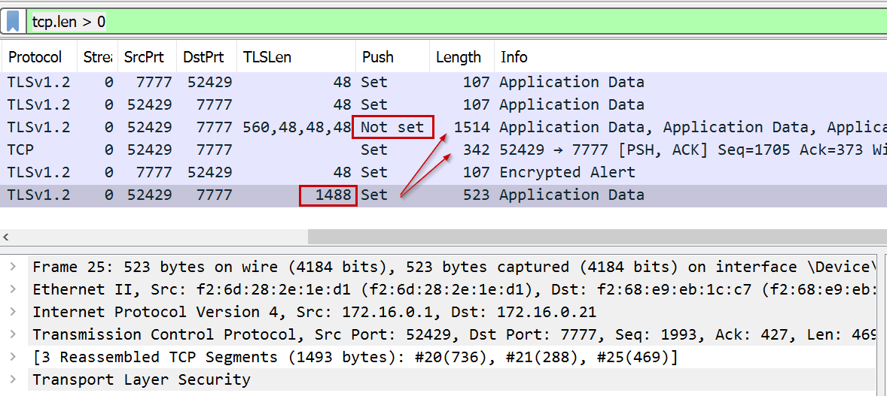
Anomaly Detection
Back to Dataset: 2a_LocalController.pcapng with tcp.len > 0
TLS Record crosses segment boundary and PSH bit is not always set when a complete record exists

Slide 35
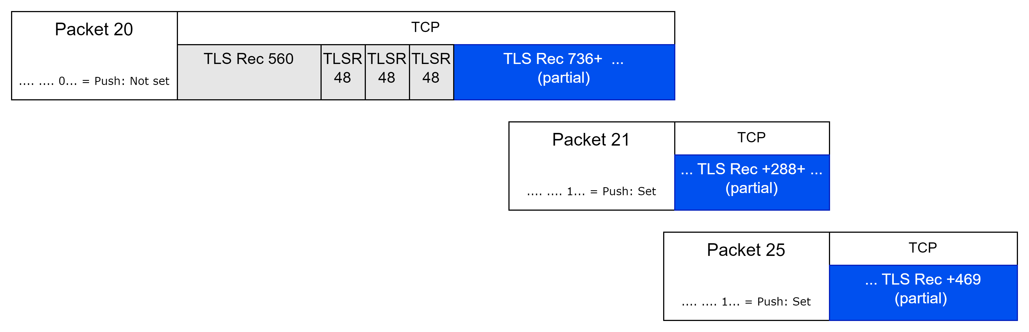
Anomaly Detection

Slide 36
Anomaly Detection
Reproducible – we have correlation but don’t know if packet 21 is a trigger, or just represents delay
Encrypted Alert shows up here

Slide 37


Anomaly Detection
“Correlation does not imply causation”
Well known fact

Slide 38
Anomaly Detection
“Correlation does not imply causation”
Well known fact
“Causation does imply correlation”
Lesser-known fact
$$Causation∈\{Correlation1, Correlation2, …, CorrelationN\}$$
Notes:
We look for the set of things that correlate, and hope that one of them turns out to have a causal relationship

Slide 39
Hypothesis Test 1
Server cannot handle PSH bit set for incomplete TLS records
-- Doubt this has anything to do with our problem
++ Easy to test so why not (I need special HW)
Test: clear PSH bit in the client → server data stream of specific incomplete TLS record. Do we get any change in behavior? Looking for any signal: success/failure, change in log message, no log message, etc.
Do I have control? Can I move the needle?

Slide 40
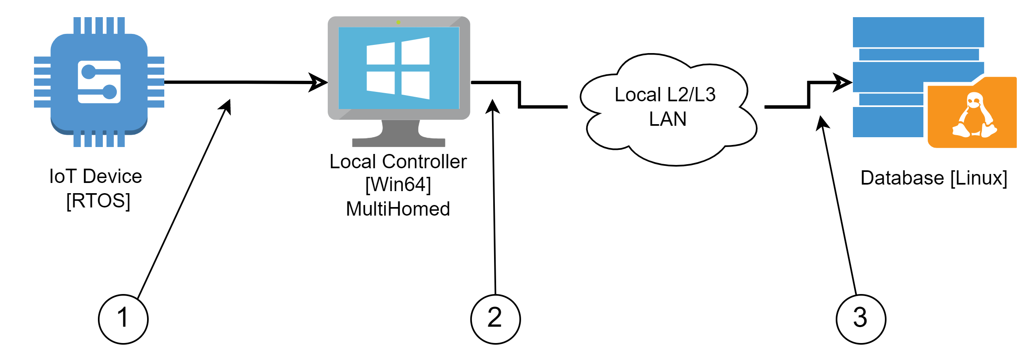
Packet Mangling
Where?
1/ Source of data, but we know Local Controller changes traffic flow
2/ Probably OK, but must ensure no changes in flow across LAN
3/ Server seems to have the problem and all changes are in effect
Notes:
Notice not focused on trigger to report generation? That piece seems to be working – data is generated and a nok log is generated so seems like trigger is ok.

Slide 41

Packet Mangling
Where?
1/ Source of data, but we know Local Controller changes traffic flow
2/ Probably OK, but must ensure no changes in flow across LAN
3/ Server seems to have the problem and all changes are in effect

Slide 42
Packet Mangling
Where?
1/ Source of data, but we know Local Controller changes traffic flow
2/ Probably OK, but must ensure no changes in flow across LAN
3/ Server seems to have the problem and all changes are in effect

Slide 43

Packet Mangling
Where?
1/ Source of data, but we know Local Controller changes traffic flow
2/ Probably OK, but must ensure no changes in flow across LAN
3/ Server seems to have the problem and all changes are in effect

Slide 44
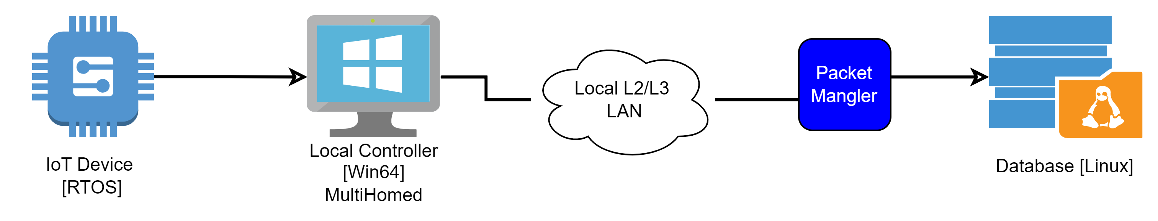
Packet Mangling
Note the operation
Select TCP traffic
At given frame offset, set bit[s] or byte[s]
Recalculate TCP/IP/Eth checksums

Slide 45
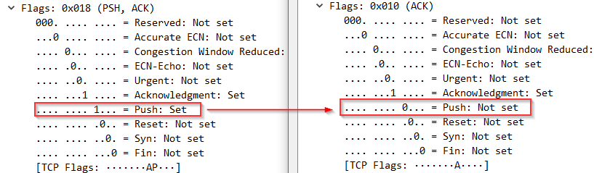
Packet Mangling

Slide 46
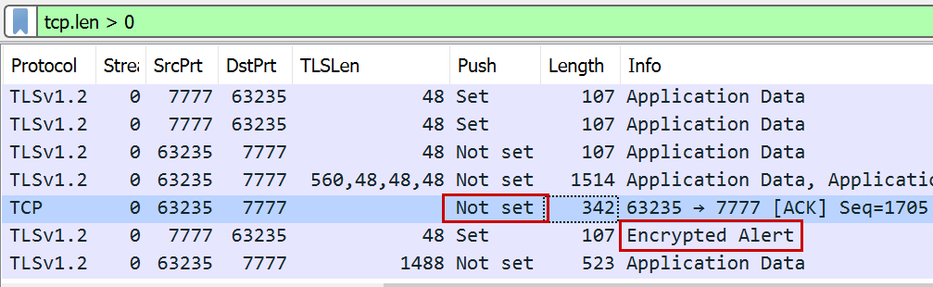
Hypothesis Test 1
Dataset: 4_LocalCtrlClearPUSH.pcapng
Review change in PSH bit; no effect on system behavior

Slide 47

Hypothesis Test 2
Server can’t handle TLS records that cross segment boundary
Approach to test
Make my own client and vary parameters (MSS, timing) to get TLS records to move within the segments
Use Python and a lot of Google/Stack Exchange
Might use ChatGPT today…
No developer here – don’t play one at work, didn’t sleep at a Holiday Inn Express last night, so a lot of Google
Notes:
Wireshark provides a fundamental advantage: know what we expect at the packet level so feedback is fast

Slide 48

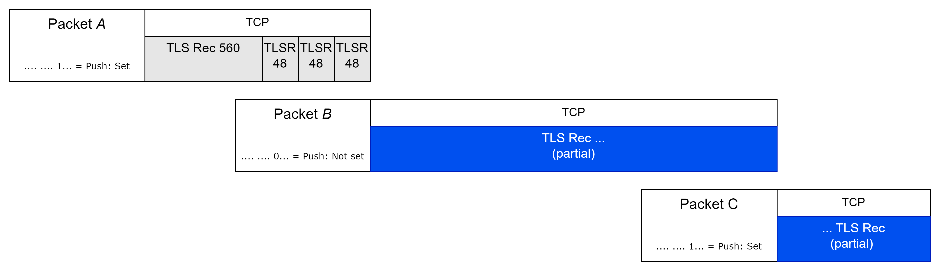
Change Segmentation
Try to do this w/o a product
Why? Because I can’t, not sure development team can in any reasonable time and sometimes we go fishing… not always easy to convince others to spend time and money on a fishing trip

Slide 49
Change Segmentation
Step 1 – figure out how to make my own client
-- Don’t know protocol or if we have enough to fake it
-- No guarantee of success in even running the test
++ Lots of Python information on Stack Exchange
++ Wireshark exported client-side protocol for us(!)
++ Relatively easy to try
https://pypi.org/project/sslpsk/
https://www.geeksforgeeks.org/read-a-file-line-by-line-in-python/
Notes:
Line by line even does the EOL characters strip!

Slide 50
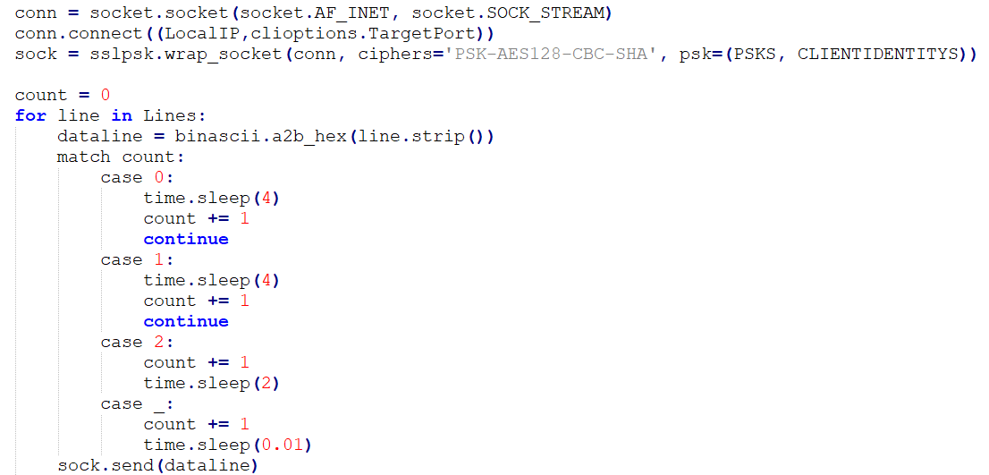
Change Segmentation
Read Wireshark output line by line and strip LF, convert to bin
Adjust timing on a per-line basis → corresponds to per application message from original ‘good’ test
Default timing per message
Send message

Slide 51

Change Segmentation
Validation: Does test client fail in same way as system?
Inject bytes into server with no controls in place
Dataset: 5_LocalCtrl_nodly_fail.pcapng
Name of file gives you the hint
Encrypted Alert moved, but notice timing: MUCH faster now
Suspect that same failure mode, but sending data faster means relative time of Alert is delayed
Log files on server indicate same failure mode

Slide 52
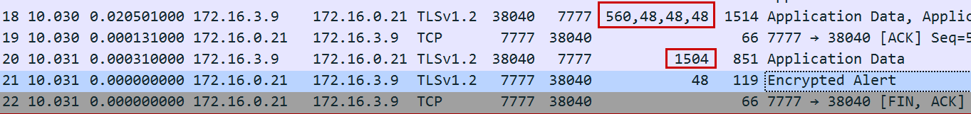
Change Segmentation
Validation: If we replicate timing observed, what happens?
Dataset: 6_LocalCtrl_ReplicateDly_fail.pcapng
Adjust timing in python: add time.sleep() at specific lines of input to provide better control
Moved from 3 packets → 2, but still fails when this 5th TLS record is split

Slide 53
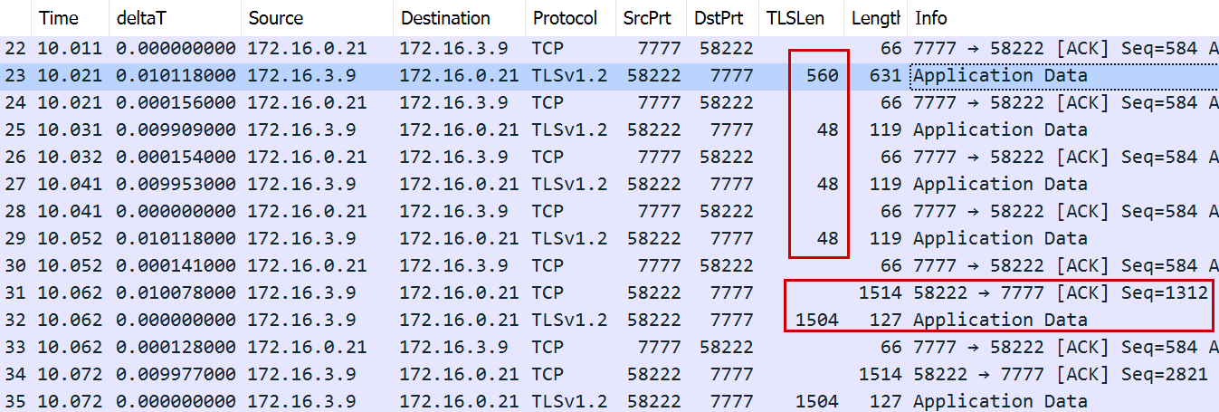
Change Segmentation
Hypothesis Test: Force each TLS record as separate segment(s)
Dataset: 7_LocalCtrl_AddDly_ok.pcapng
Add 10ms per command (which is a line in the exported file from Wireshark)
It works!
Four TLS records no longer share a partial 5th
560byte record is now by itself
5th record is now 1504bytes instead of 1488

Slide 54
Change Segmentation
We got the needle to move!
Major success – hypothesis: Server can’t handle mixed partial and complete TLS records in a given segment
Server software teams says ‘all of this network handling comes from a base class’
… And we have never seen this problem before…

Slide 55
Change Segmentation
Hypothesis Test: Force each TLS record as separate segment(s) using MSS clamping instead of timing
Linux host so straightforward; firewalls can often do it too
Dataset: 8_LocalCtrl_mssClamp_fail.pcapng
[user@ws]$ sudo ip route add 10.227.1.36/32 via 10.228.1.1 advmss 565 [user@ws]$ netstat -rn Kernel IP routing table Destination Gateway Genmask Flags MSS Window irtt Iface 0.0.0.0 10.228.1.1 0.0.0.0 UG 0 0 0 nic0 169.254.0.0 0.0.0.0 255.255.0.0 U 0 0 0 nic0 10.227.1.36 10.228.1.1 255.255.255.255 UGH 605 0 0 nic0 10.228.0.0 0.0.0.0 255.255.0.0 U 0 0 0 nic0

Slide 56
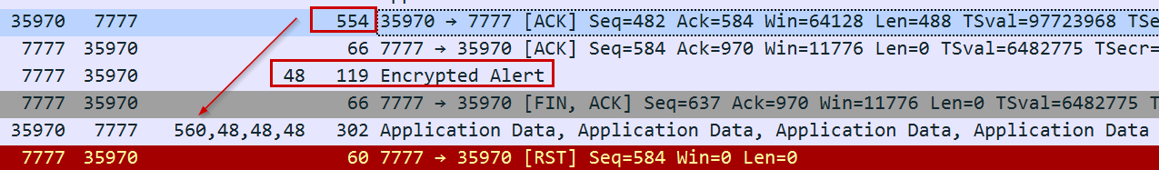
Change Segmentation
MSS is 500, so first 560byte TLS record is split
Server does not like this
We got more information now – it is not just the 5th split record, if the first record is split it fails
But… notice from 7_LocalCtrl_AddDly_ok.pcapng, plenty of split records after the first few
Remember: same base class handling communications (?)

Slide 57
Change Segmentation
Lets vary MSS until we get a change in behavior
Dataset: 9_LocalCtrl_mssClamp_increase.pcapng
Useful filter
(tcp.len > 0) || (tcp.options.mss_val)
Column callout: tcp.options.mss_val
Conclude: when MSS is sufficient to fully contain 560byte TLS record in this position of protocol, system works. Cannot have a partial record here, either.
But remember… all handled by same base class
It works!

Slide 58
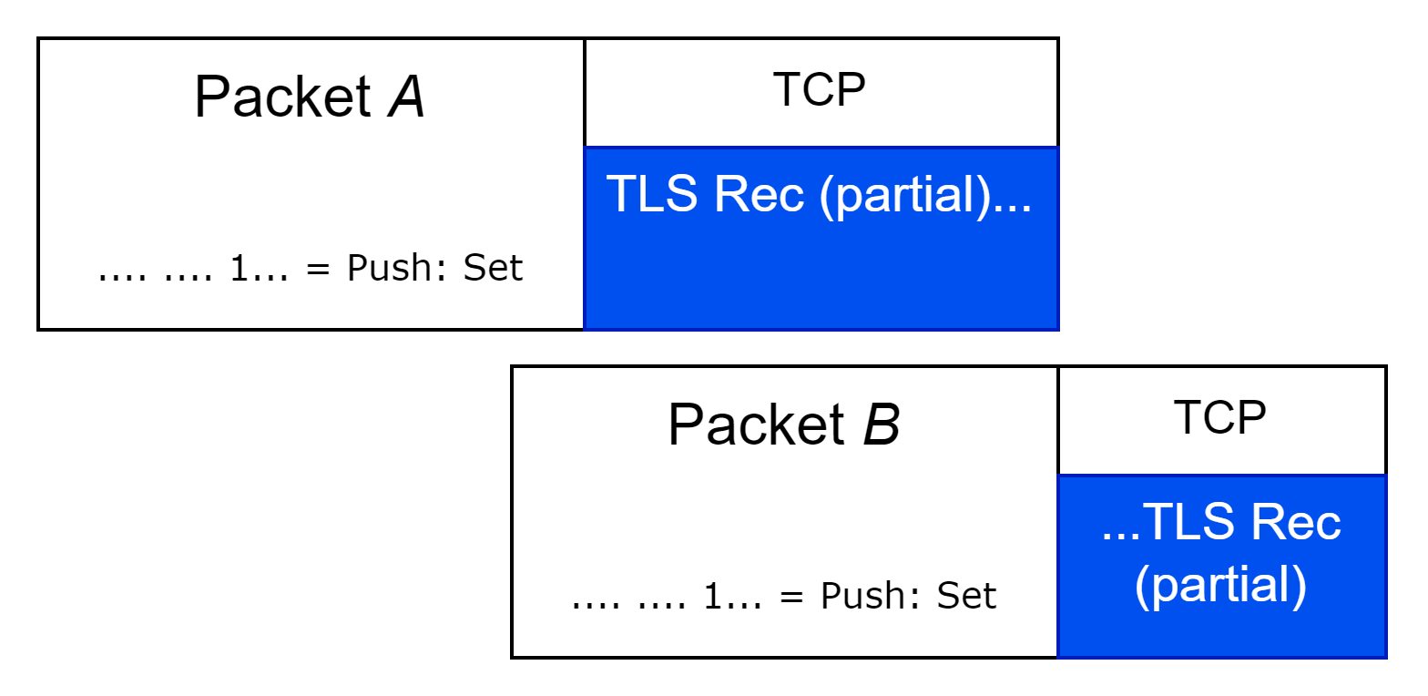
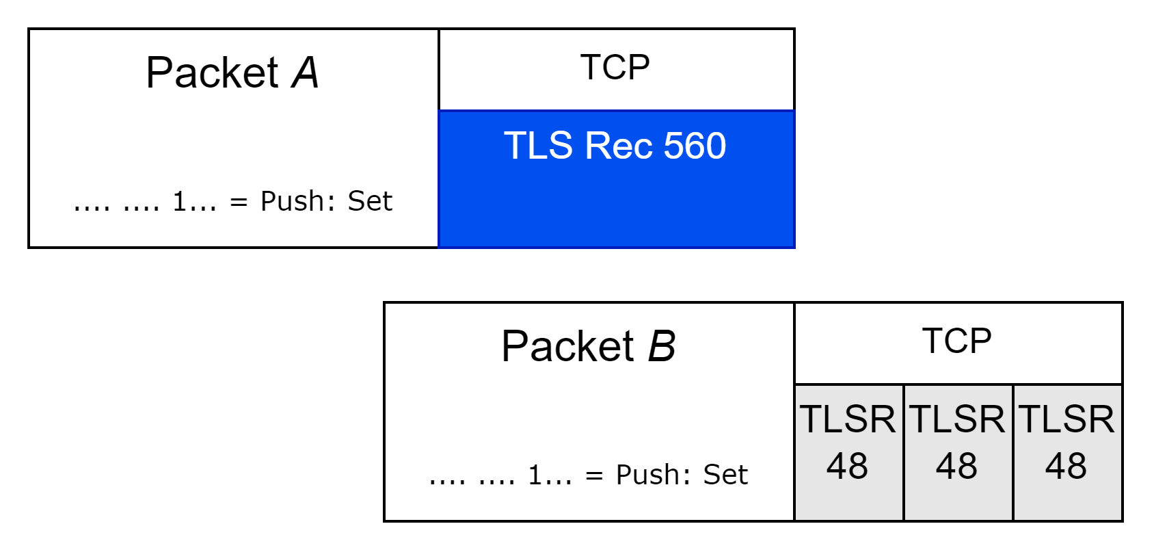
Change Segmentation

Slide 59
Conclusion
Root cause from network POV is isolated to server handling of specific TLS record segmentation
Why? I have no idea! That is a C++ software developer question…
Behavior is allowed per RFC, so implementation defect
Base class so all behavior should be the same is not supported (my interpretation)
Local Controller does not behave the way team thinks it does
No impact here
We did not find true root cause, but able to point software team to narrow code area and fix generated in less than an hour

Slide 60
Providing More Value
Packet capture and analysis provides for indication of what and how it may have failed – but not the critical why
Closed-box testing with packet capture as our guide to move the needle helps reduce the problem space leading to faster time to resolution
Hypothesis testing of observable correlation conditions relative to failure guided us to a solution
Wireshark enabled relatively easy protocol replication

Slide 61
Baseball Analogy
Double/Second Base: Client or server?
Triple/Third Base: Look here on the problem system
Single: Not the network
(Walk: you should have known it’s not the network but you make me say it anyway)
Home Run: change this specific thing and your problem will be gone…

Slide 62
Baseball Analogy
Double/Second Base: Client or server?
Triple/Third Base: Look here on the problem system
Single: Not the network
(Walk: you should have known it’s not the network but you make me say it anyway)
Home Run: change this specific thing and your problem will be gone…

Slide 63
Thank you! Please provide feedback per conference guidelines

